Slide 1

Unit1
Number Systems
College of Computer and Information Sciences
Department of Computer Science
CSC 220: Computer Organization

Slide 2
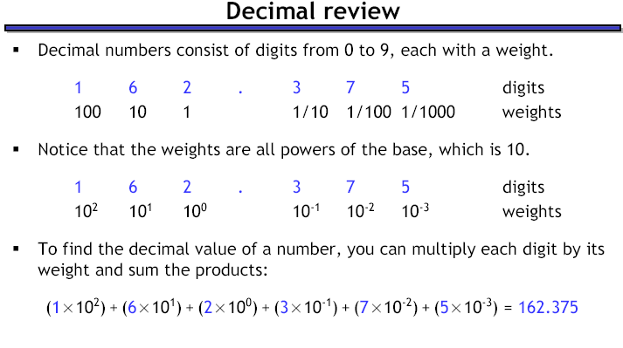

Slide 3
Common Number Systems
System | Base | Symbols | Used by humans? | Used in computers?
Decimal | 10 | 0, 1, … 9 | Yes | No
Binary | 2 | 0, 1 | No | Yes
Octal | 8 | 0, 1, … 7 | No | No
Hexa- decimal | 16 | 0, 1, … 9, A, B, … F | No | No

Slide 4
Quantities/Counting (1 of 3)
Decimal | Binary | Octal | Hexa- decimal
0 | 0 | 0 | 0
1 | 1 | 1 | 1
2 | 10 | 2 | 2
3 | 11 | 3 | 3
4 | 100 | 4 | 4
5 | 101 | 5 | 5
6 | 110 | 6 | 6
7 | 111 | 7 | 7

Slide 5
Quantities/Counting (2 of 3)
Decimal | Binary | Octal | Hexa- decimal
8 | 1000 | 10 | 8
9 | 1001 | 11 | 9
10 | 1010 | 12 | A
11 | 1011 | 13 | B
12 | 1100 | 14 | C
13 | 1101 | 15 | D
14 | 1110 | 16 | E
15 | 1111 | 17 | F

Slide 6
Quantities/Counting (3 of 3)
Decimal | Binary | Octal | Hexa- decimal
16 | 10000 | 20 | 10
17 | 10001 | 21 | 11
18 | 10010 | 22 | 12
19 | 10011 | 23 | 13
20 | 10100 | 24 | 14
21 | 10101 | 25 | 15
22 | 10110 | 26 | 16
23 | 10111 | 27 | 17
Etc.

Slide 7
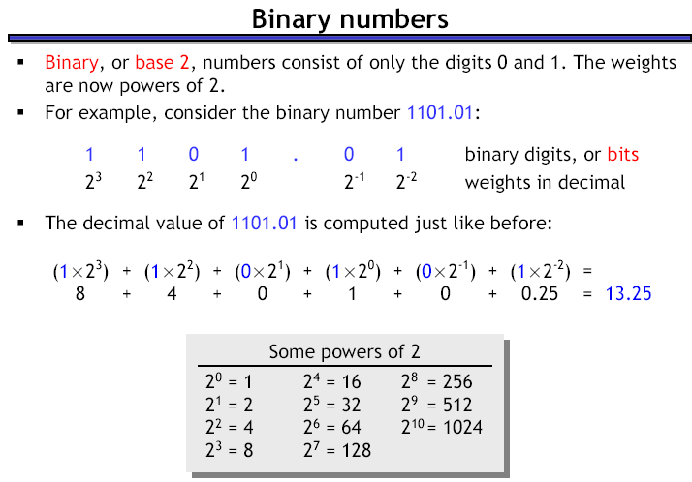

Slide 8
Conversion Among Bases
The possibilities:
Decimal
Octal
Binary
Hexadecimal

Slide 9
Quick Example
25₁₀ = 11001₂ = 31₈ = 19₁₆
Base

Slide 10
Decimal to Decimal (just for fun)
Decimal
Octal
Binary
Hexadecimal

Slide 11
Weight
125₁₀ => 5 x 10⁰ = 5
2 x 10¹ = 20
1 x 10² = 100
125
Base

Slide 12
Binary to Decimal
Decimal
Octal
Binary
Hexadecimal

Slide 13
Binary to Decimal
Technique
  Multiply each bit by 2^{n}, where n is the “weight” of the bit
  The weight is the position of the bit, starting from 0 on the right
  Add the results

Slide 14
Example
Bit “0”
101011₂ => 1 x 2⁰ = 1
1 x 2¹ = 2
0 x 2² = 0
1 x 2³ = 8
0 x 2⁴ = 0
1 x 2⁵ = 32
43₁₀

Slide 15
Converting Binary to Decimal
What is the decimal equivalent of the binary number 1101110?
1 x 2⁶ = 1 x 64 = 64
+ 1 x 2⁵ = 1 x 32 = 32
+ 0 x 2⁴ = 0 x 16 = 0
+ 1 x 2³ = 1 x 8 = 8
+ 1 x 2² = 1 x 4 = 4
+ 1 x 2¹ = 1 x 2 = 2
+ 0 x 2º = 0 x 1 = 0
= 110 in base 10
13

Slide 16
Octal to Decimal
Decimal
Octal
Binary
Hexadecimal

Slide 17
Octal to Decimal
Technique
  Multiply each bit by 8^{n}, where n is the “weight” of the bit
  The weight is the position of the bit, starting from 0 on the right
  Add the results

Slide 18
Example
724₈ => 4 x 8⁰ = 4
2 x 8¹ = 16
7 x 8² = 448
468₁₀

Slide 19
Hexadecimal to Decimal
Decimal
Octal
Binary
Hexadecimal

Slide 20
Hexadecimal to Decimal
Technique
  Multiply each bit by 16^{n}, where n is the “weight” of the bit
  The weight is the position of the bit, starting from 0 on the right
  Add the results

Slide 21
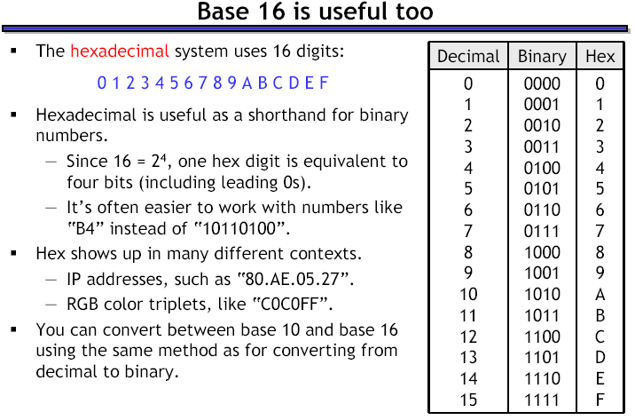

Slide 22
Example
ABC₁₆ => C x 16⁰ = 12 x 1 = 12
B x 16¹ = 11 x 16 = 176
A x 16² = 10 x 256 = 2560
2748₁₀

Slide 23
Decimal to Binary
Decimal
Octal
Binary
Hexadecimal

Slide 24
Decimal to Binary
Technique
  Divide by two, keep track of the remainder
  First remainder is bit 0 (LSB, least-significant bit)
  Second remainder is bit 1
  Etc.

Slide 25
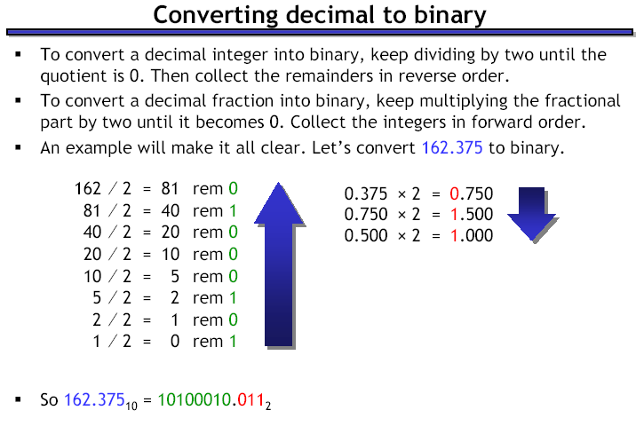

Slide 26
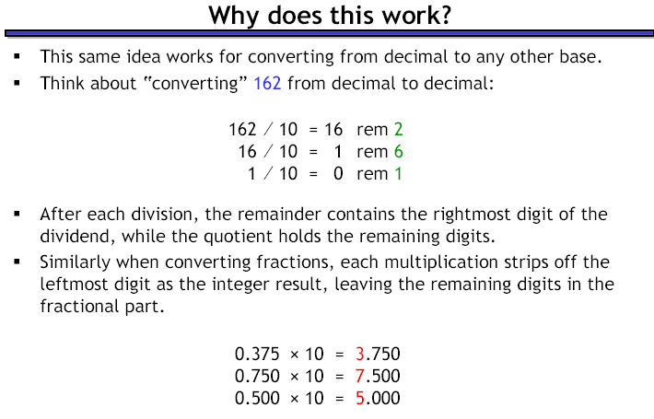

Slide 27
Example
125₁₀ = ?₂
2 125
62 1
2
31 0
2
15 1
2
7 1
2
3 1
2
1 1
2
0 1
125₁₀ = 1111101₂

Slide 28
Decimal to Octal
Decimal
Octal
Binary
Hexadecimal

Slide 29
Decimal to Octal
Technique
  Divide by 8
  Keep track of the remainder

Slide 30
Example
1234₁₀ = ?₈
8 1234
154 2
8
19 2
8
2 3
8
0 2
1234₁₀ = 2322₈

Slide 31
Decimal to Hexadecimal
Decimal
Octal
Binary
Hexadecimal

Slide 32
Decimal to Hexadecimal
Technique
  Divide by 16
  Keep track of the remainder

Slide 33
Example
1234₁₀ = ?₁₆
16 1234
77 2
16
4 13 = D
16
0 4
1234₁₀ = 4D2₁₆

Slide 34
Octal to Binary
Decimal
Octal
Binary
Hexadecimal

Slide 35
Octal to Binary
Technique
  Convert each octal digit to a 3-bit equivalent binary representation

Slide 36
Example
705₈ = ?₂
7 0 5
111 000 101
705₈ = 111000101₂

Slide 37
Hexadecimal to Binary
Decimal
Octal
Binary
Hexadecimal

Slide 38
Hexadecimal to Binary
Technique
  Convert each hexadecimal digit to a 4-bit equivalent binary representation

Slide 39
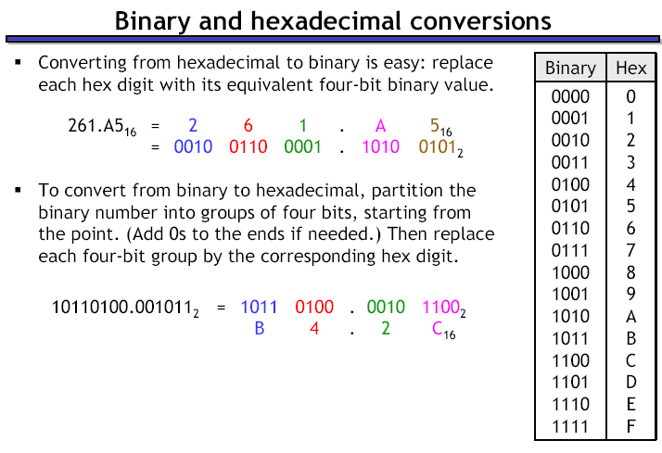

Slide 40
Example
10AF₁₆ = ?₂
1 0 A F
0001 0000 1010 1111
10AF₁₆ = 0001000010101111₂

Slide 41
Binary to Octal
Decimal
Octal
Binary
Hexadecimal

Slide 42
Binary to Octal
Technique
  Group bits in threes, starting on right
  Convert to octal digits

Slide 43
Example
1011010111₂ = ?₈
1 011 010 111
1 3 2 7
1011010111₂ = 1327₈

Slide 44
Binary to Hexadecimal
Decimal
Octal
Binary
Hexadecimal

Slide 45
Binary to Hexadecimal
Technique
  Group bits in fours, starting on right
  Convert to hexadecimal digits

Slide 46
Example
1010111011₂ = ?₁₆
10 1011 1011
B B
1010111011₂ = 2BB₁₆

Slide 47
Octal to Hexadecimal
Decimal
Octal
Binary
Hexadecimal

Slide 48
Octal to Hexadecimal
Technique
  Use binary as an intermediary

Slide 49
Example
1076₈ = ?₁₆
1 0 7 6
001 000 111 110
2 3 E
1076₈ = 23E₁₆

Slide 50
Hexadecimal to Octal
Decimal
Octal
Binary
Hexadecimal

Slide 51
Hexadecimal to Octal
Technique
  Use binary as an intermediary

Slide 52
Example
1F0C₁₆ = ?₈
1 F 0 C
0001 1111 0000 1100
1 7 4 1 4
1F0C₁₆ = 17414₈

Slide 53
Exercise – Convert ...
Decimal | Binary | Octal | Hexa- decimal
33
 | 1110101
 |  | 703
 |  |  | 1AF
Don’t use a calculator!
Skip answer
Answer

Slide 54
Exercise – Convert …
Answer
Decimal | Binary | Octal | Hexa- decimal
33 | 100001 | 41 | 21
117 | 1110101 | 165 | 75
451 | 111000011 | 703 | 1C3
431 | 110101111 | 657 | 1AF

Slide 55
Common Powers (1 of 2)
Base 10
Power | Preface | Symbol
10⁻¹² | pico | p
10⁻⁹ | nano | n
10⁻⁶ | micro | μ
10⁻³ | milli | m
10³ | kilo | k
10⁶ | mega | M
10⁹ | giga | G
10¹² | tera | T
Value
.000000000001
.000000001
.000001
.001
1000
1000000
1000000000
1000000000000

Slide 56
Common Powers (2 of 2)
Base 2
Power | Preface | Symbol
2¹⁰ | kilo | k
2²⁰ | mega | M
2³⁰ | Giga | G
Value
1024
1048576
1073741824
What is the value of “k”, “M”, and “G”?
In computing, particularly w.r.t. memory,
the base-2 interpretation generally applies

Slide 57
Fractions
Decimal to decimal (just for fun)
3.14 => 4 x 10⁻² = 0.04
1 x 10⁻¹ = 0.1
3 x 10⁰ = 3
3.14
pp. 46-50

Slide 58
Fractions
Binary to decimal
10.1011 => 1 x 2⁻⁴ = 0.0625
1 x 2⁻³ = 0.125
0 x 2⁻² = 0.0
1 x 2⁻¹ = 0.5
0 x 2⁰ = 0.0
1 x 2¹ = 2.0
2.6875
pp. 46-50

Slide 59
Fractions
Decimal to binary
.14579
x 2
0.29158
x 2
0.58316
x 2
1.16632
x 2
0.33264
x 2
0.66528
x 2
1.33056
etc.
3.14579
11.001001...
p. 50

Slide 60
Exercise – Convert ...
Decimal | Binary | Octal | Hexa- decimal
29.8
 | 101.1101
 |  | 3.07
 |  |  | C.82
Don’t use a calculator!
Skip answer
Answer

Slide 61
Exercise – Convert …
Answer
Decimal | Binary | Octal | Hexa- decimal
29.8 | 11101.110011… | 35.63… | 1D.CC…
5.8125 | 101.1101 | 5.64 | 5.D
3.109375 | 11.000111 | 3.07 | 3.1C
12.5078125 | 1100.10000010 | 14.404 | C.82

Slide 62
4-Bit Binary Coded Decimal (BCD) Systems
The 4-bit BCD system is usually employed by the computer systems to represent and process numerical data only. In the 4-bit BCD system, each digit of the decimal number is encoded to its corresponding 4-bit binary sequence. The two most popular 4-bit BCD systems are:

Slide 63

4-Bit BCD Code
Decimal digits | Weighted 4-bit BCD code
0 | 0000
1 | 0001
2 | 0010
3 | 0011
4 | 0100
5 | 0101
6 | 0110
7 | 0111
8 | 1000
9 | 1001

Slide 64
4-Bit BCD Code
Represent the decimal number 5327 in BCD code.
The corresponding 4-bit BCD representation of decimal digit 5 is 0101
The corresponding 4-bit BCD representation of decimal digit 3 is 0011
The corresponding 4-bit BCD representation of decimal digit 2 is 0010
The corresponding 4-bit BCD representation of decimal digit 7 is 0111
Therefore, the BCD representation of decimal number 5327 is 0101001100100111.

Slide 65
Thank you

